Slide 1
Enhancing UNet-driven T1-weighted Brain Magnetic Resonance Image Segmentation using Post-processing Techniques
MDSC 689.03 Final Project
Mahsa Dibaji
Graduate Research Assistant
Electrical and Software Engineering Department
April 11th, 2023

Slide 2




Introduction
Brain segmentation is vital for any brain analysis task
Traditional methods
CNNs
Sensitive to noise
Sensitive to intensity variations
Time consuming
Need for large labeled dataset
overfitting
Sensitive to hyperparameter choices
This Project
Combining CNNs, traditional, and post-processing techniques
utilizing benefits, overcoming drawbacks
Notes:
There are some traditional methods which were widely used in the past. But some of there limitations are that their accuracy is sensitive to noise and intensity variations in images, and these methods are time-consuming
On the otherhand, CNNs are faster and require less effort but they still have limitations such as needing large datasets to have a good performance otherwise they might overfit and not generalize well. They are also sensitive to hyperparameter choices.
The idea behind this project is to get the benefit of both approaches, and address some of their limitations

Slide 3
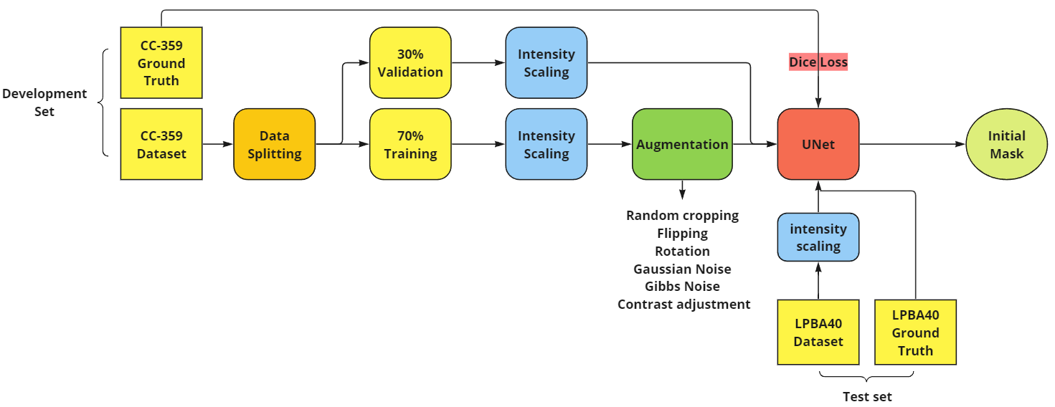
Initial Segmentation: UNet

Slide 4
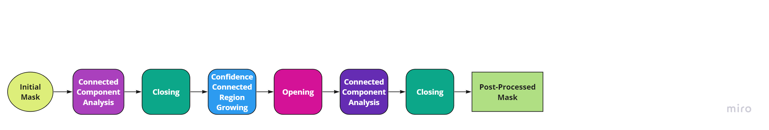
Post-Processing Pipeline

Slide 5
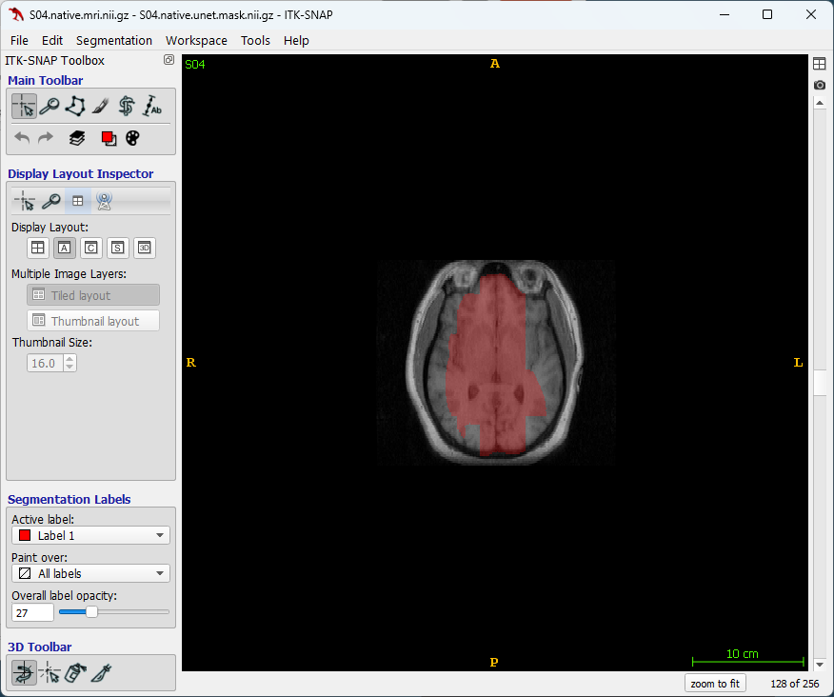
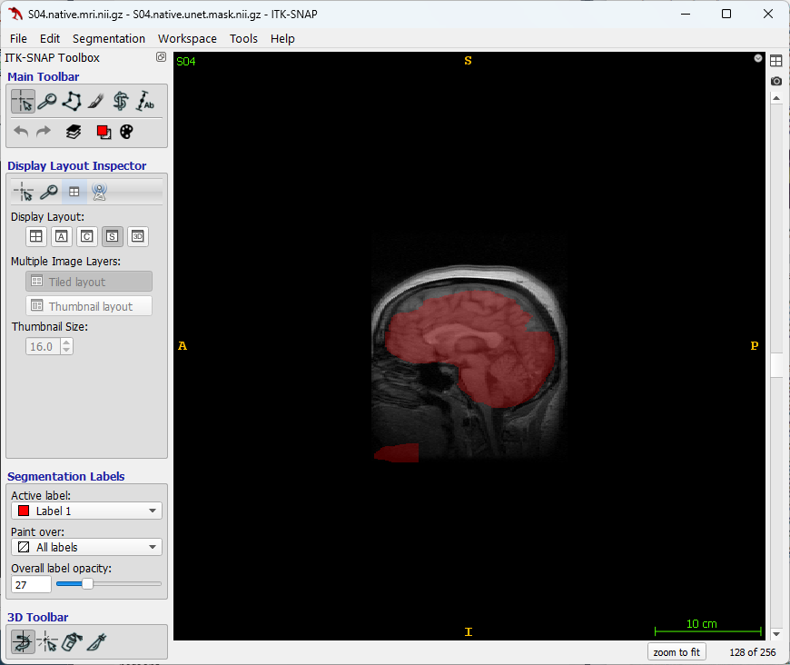
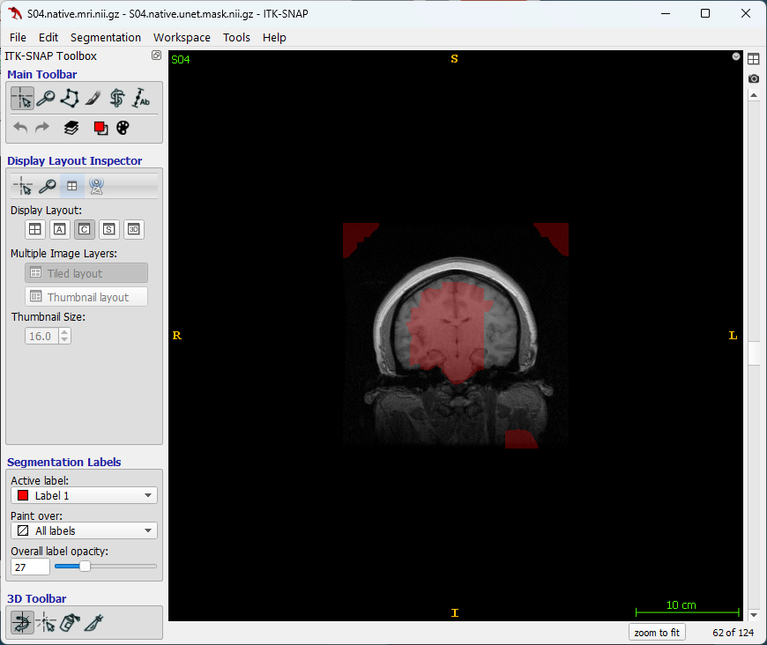
Post-Processing Pipeline
Notes:
Here we can see a sample initial mask predicted by Unet model

Slide 6
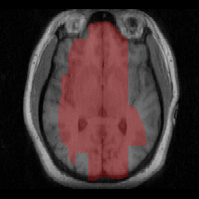
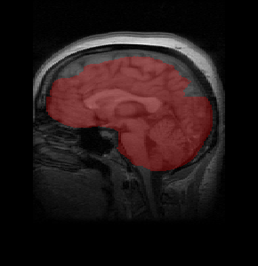
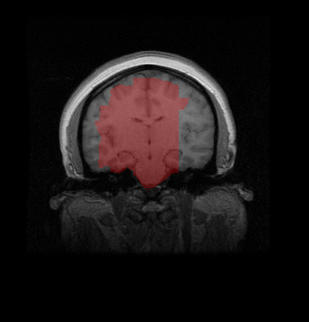
Post-Processing Pipeline
Notes:
As the first step, I used connected component analysis to remove any irrelevant segmented region from the mask, followed by a closing operation to fill any holes.

Slide 7
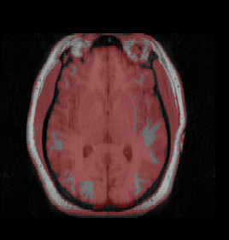
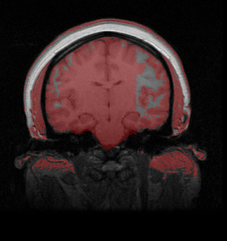
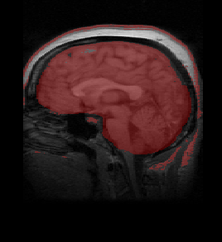
Post-Processing Pipeline
Notes:
Then I used Confidence connected region growing in order to expand the segmentation mask to cover more regions in the brain.
It required initializing a seed point. so I chosed a point which is close to the center of segmented region and also has an intensity close to the average intensity in the segmented region.
The method iteratively explores neighbors of that seed and add those to the segmented region if they pass the specified criteria.

Slide 8
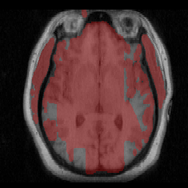
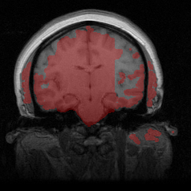
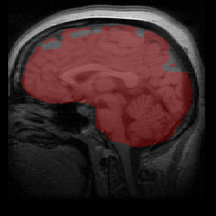
Post-Processing Pipeline
Notes:
Then performed opening to discard small unwanted segmented regions

Slide 9
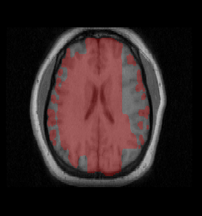
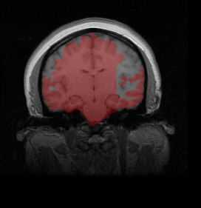
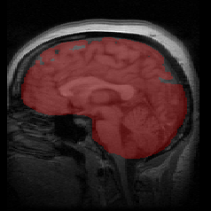
Post-Processing Pipeline
Notes:
Followed by another connected component analysis to again keep the largest one

Slide 10
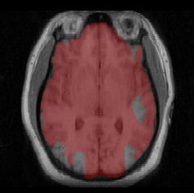
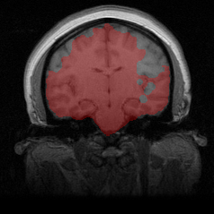
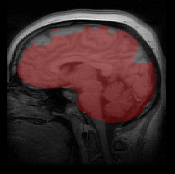
Post-Processing Pipeline
Notes:
Then I again performed closing to fill the possible holes.

Slide 11
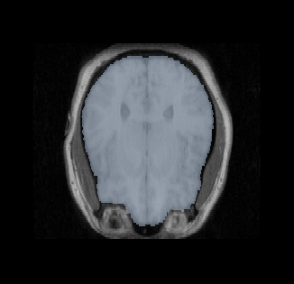
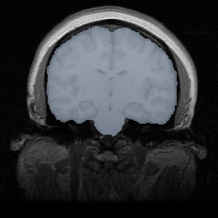
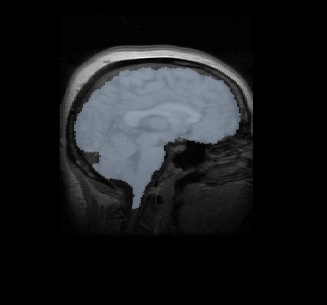
Post-Processing Pipeline
(a)
(b)
(c)
Notes:
Then I again performed closing to fill the possible holes.

Slide 12
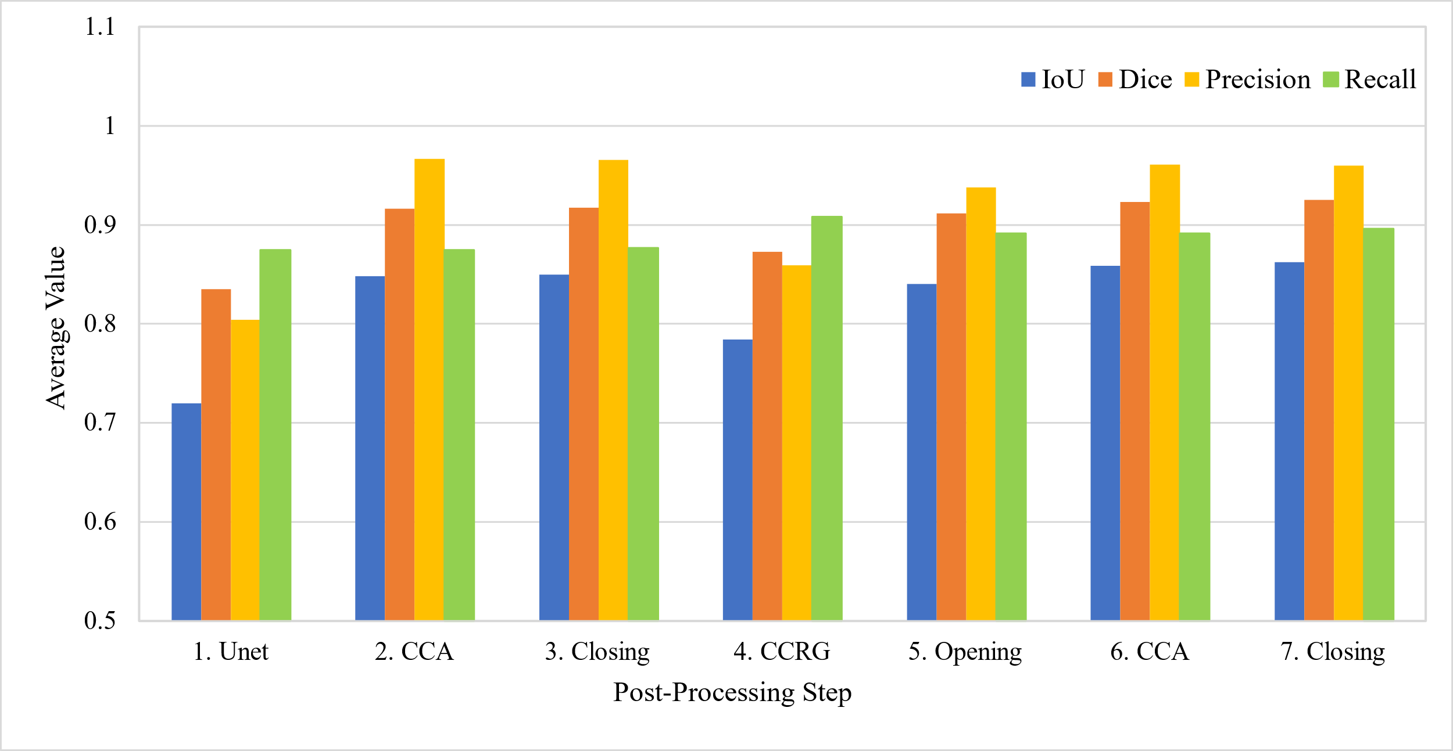
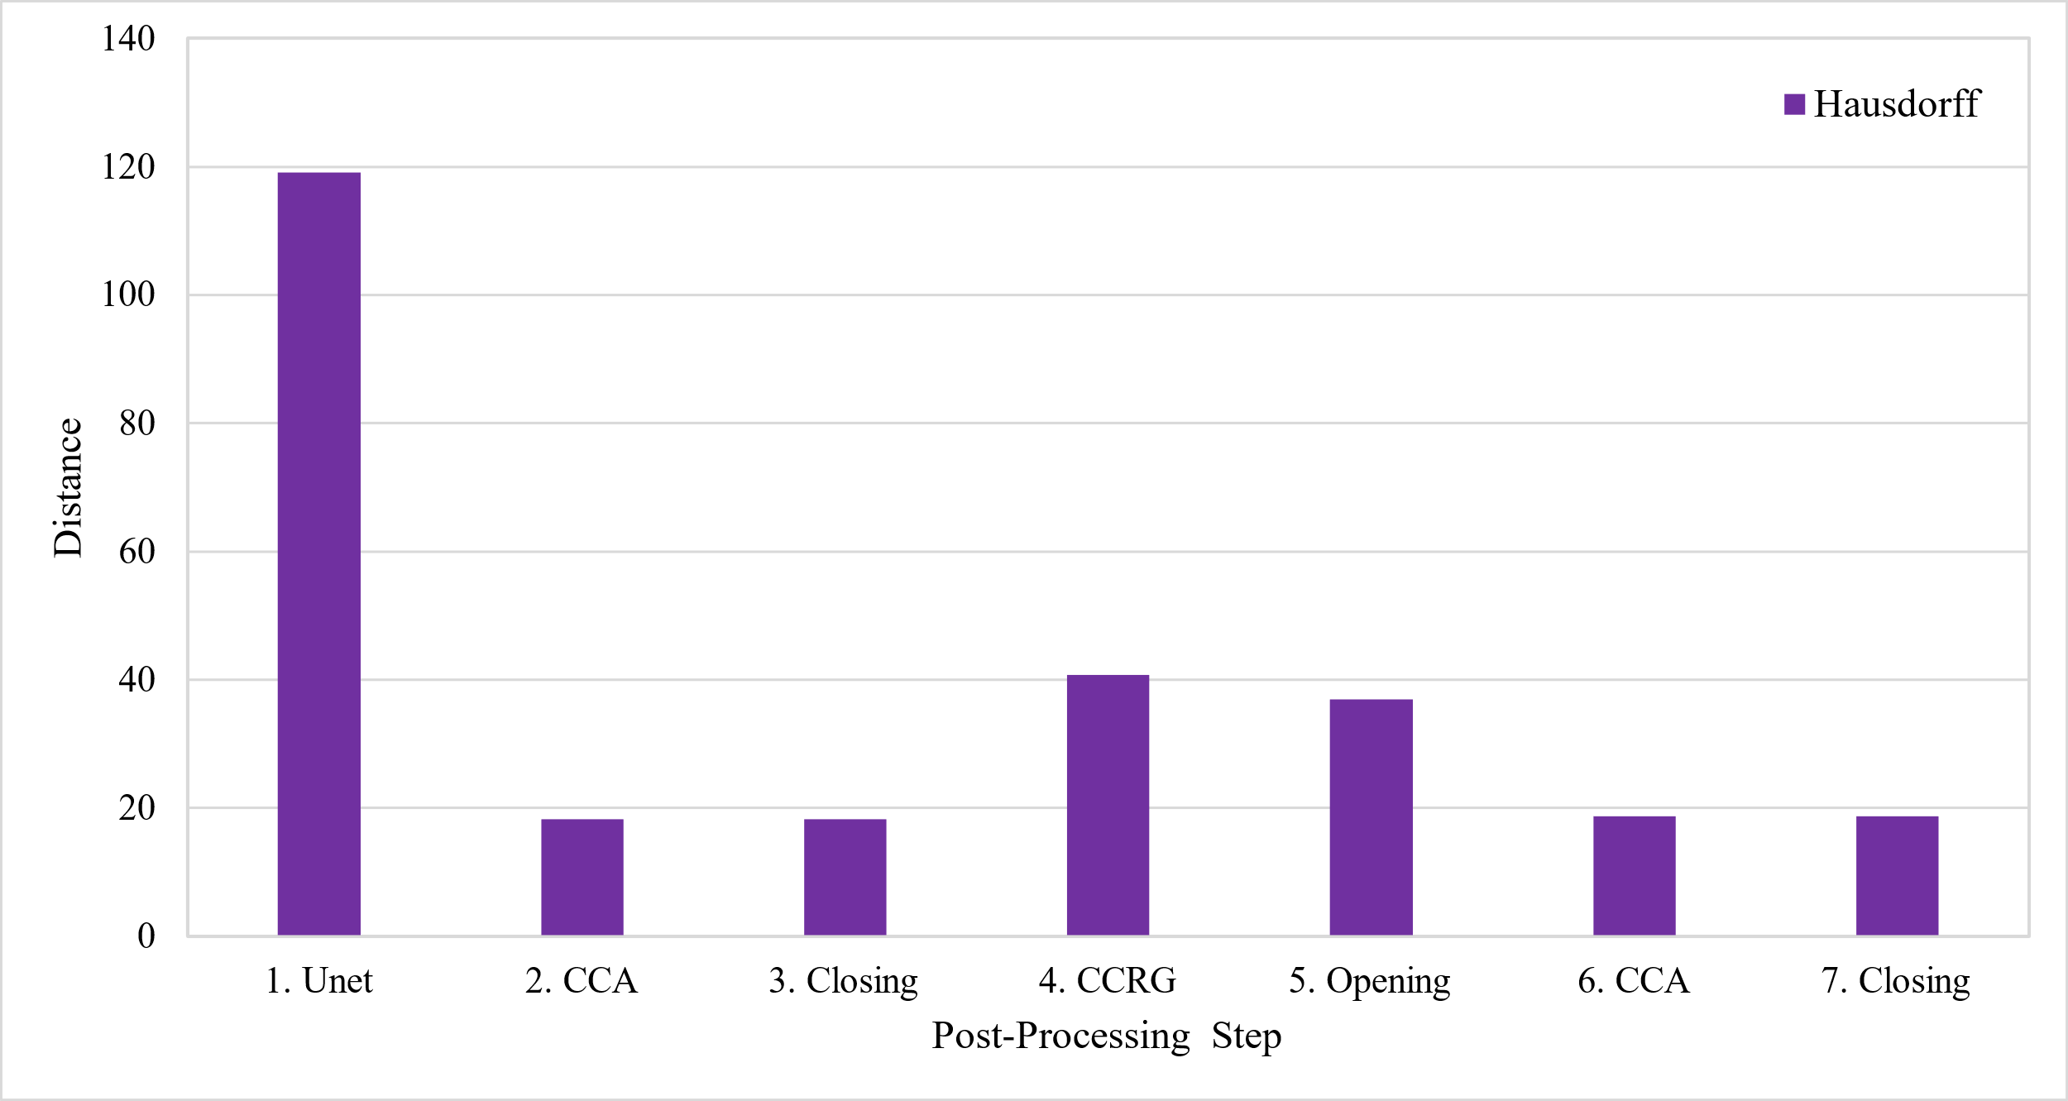
Evaluation Results
Notes:
In order to evaluate the performance of the method, I used some metrics such as Jaccard Index, Dice coefficient, Precision, recall, and Hausdorff distance
On the left figure, we can see the average value of each metric after each step of the method.
On the write we can see the same for the average hausdorff distance

Slide 13
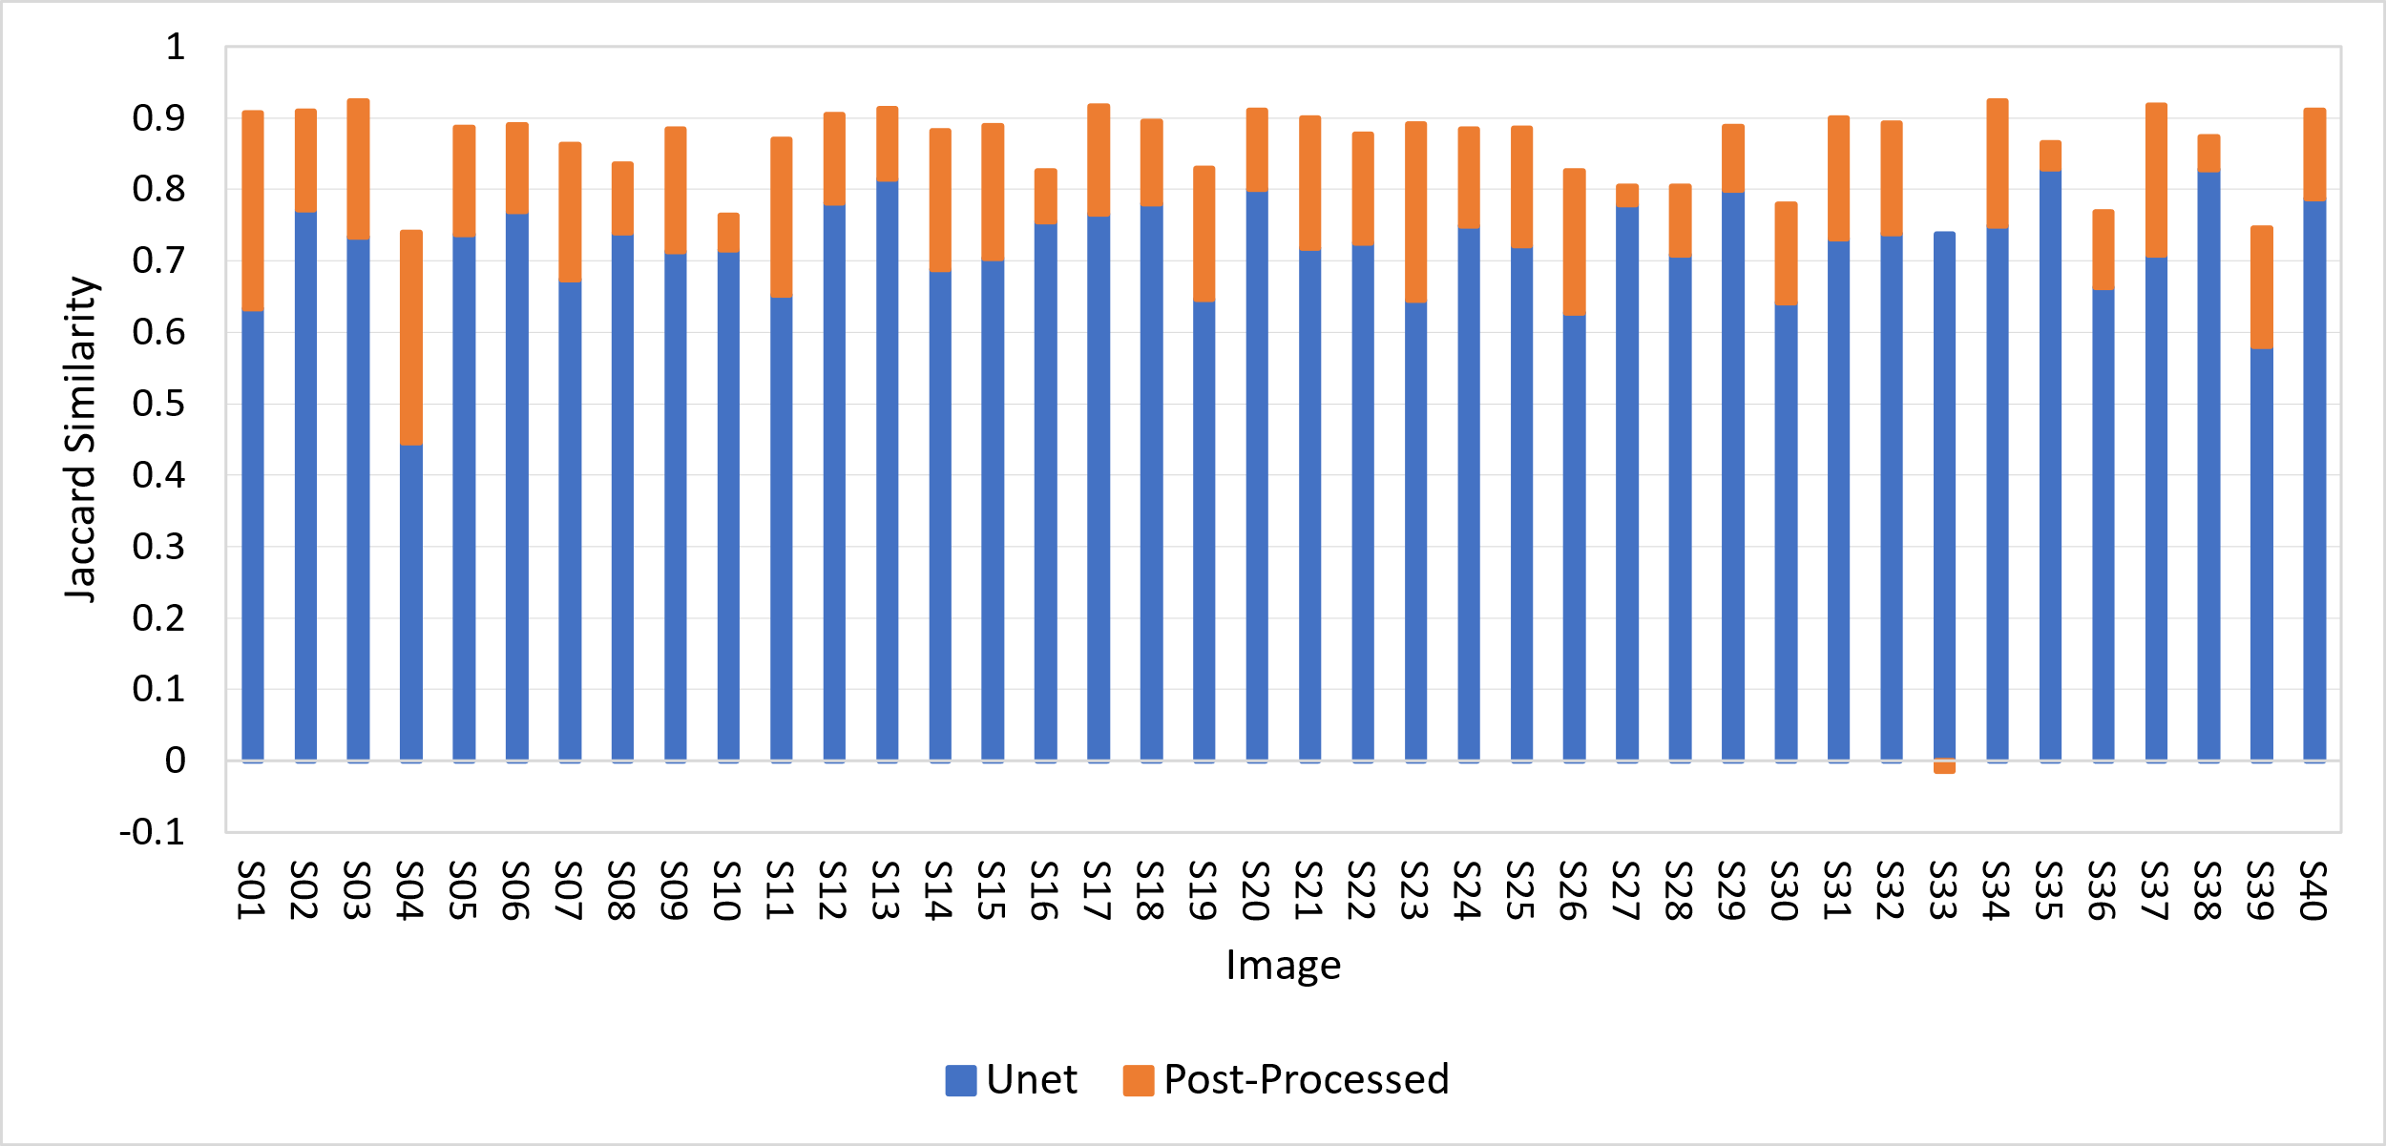
Results
Notes:
In this figure, we can see the Jaccard Similarity increased after the post-processing pipeline for almost all the images.

Slide 14





Limitation and Future Works
Dataset limitations
Generalizability concerns
Combined computational cost
Dependence on initial CNN performance
Post-processing technique selection
Notes:
Other techniques and CNN architectures might yield better outcomes.
Performance may vary on different datasets or real-world data.
All used images are for healthy brains. Method may not be equally effective for all brain structures or pathologies.
Combined computational cost: Merging CNNs and post-processing increases resource requirements.
Limited by initial CNN performance: Post-processing effectiveness can be constrained by the quality of UNet's segmentation masks.

Slide 15
References
M. A. Balafar, A. R. Ramli, M. I. Saripan, and S. Mashohor, “Review of brain mri image segmentation methods,” Artificial Intelligence Review, vol. 33, pp. 261–274, 2010.
I. Despotovi ́c, B. Goossens, and W. Philips, “Mri segmentation of the human brain: challenges, methods, and applications,” Computational and mathematical methods in medicine, vol. 2015, 2015.
Z. Akkus, A. Galimzianova, A. Hoogi, D. L. Rubin, and B. J. Erickson, “Deep learning for brain mri segmentation: state of the art and future directions,” Journal of digital imaging, vol. 30, pp. 449–459, 2017.
R. Souza, O. Lucena, J. Garrafa, D. Gobbi, M. Saluzzi, S. Appenzeller, L. Rittner, R. Frayne, and R. Lotufo, “An open, multi-vendor, multi-field-strength brain mr dataset and analysis of publicly available skull stripping methods agreement,” NeuroImage, vol. 170, pp. 482–494, 2018.
D. W. Shattuck, M. Mirza, V. Adisetiyo, C. Hojatkashani, G. Salamon, K. L. Narr, R. A. Poldrack, R. M. Bilder, and A. W. Toga, “Construction of a 3d probabilistic atlas of human cortical structures,” Neuroimage, vol. 39, no. 3, pp. 1064–1080, 2008.
R. Verma and J. Ali, “A comparative study of various types of image noise and efficient noise removal techniques,” International Journal of advanced research in computer science and software engineering, vol. 3, no. 10, 2013.
L. F. Czervionke, J. M. Czervionke, D. L. Daniels, and V. M. Haughton, “Characteristic features of mr truncation artifacts,” American journal of neuroradiology, vol. 9, no. 5, pp. 815–824, 1988.
O. Ronneberger, P. Fischer, and T. Brox, “U-net: Convolutional networks for biomedical image segmentation,” in Medical Image Computing and Computer-Assisted Intervention–MICCAI 2015: 18th International Conference, Munich, Germany, October 5-9, 2015, Proceedings, Part III 18, pp. 234–241, Springer, 2015.
P. Soille, Erosion and Dilation, pp. 63–103. Berlin, Heidelberg: Springer Berlin Heidelberg, 2004.
P. Soille, Opening and Closing, pp. 105–137. Berlin, Heidelberg: Springer Berlin Heidelberg, 2004.
L. He, X. Ren, Q. Gao, X. Zhao, B. Yao, and Y. Chao, “The connected-component labeling problem: A review of state-of-the-art algorithms,” Pattern Recognition, vol. 70, pp. 25–43, 2017.
D. L. Pham, C. Xu, and J. L. Prince, “Current methods in medical image segmentation,” Annual review of biomedical engineering, vol. 2, no. 1, pp. 315–337, 2000.
R. Adams and L. Bischof, “Seeded region growing,” IEEE Transactions on Pattern Analysis and Machine Intelligence, vol. 16, no. 6, pp. 641–647, 1994.
A. A. Taha and A. Hanbury, “Metrics for evaluating 3d medical image segmentation: analysis, selection, and tool,” BMC medical imaging, vol. 15, no. 1, pp. 1–28, 2015.

Slide 16
Thank you! ☺

